Slide 2

RAINFALL PREDICTION
using Machine Learning
By: DONA JINCE
Reg No: MAC23MCA-2024
Under the guidance of:
Prof. Sonia Abraham

Slide 3


CONTENTS
INTRODUCTION
01
LITERATURE REVIEWS
02
COMPARISON
03
PROJECT PROPOSAL
04
DATASET DESCRIPTION
05
CONCLUSION
06

Slide 4

INTRODUCTION
01
⚬Rainfall prediction is vital for agriculture, water management, disaster preparedness, and urban planning, helping to mitigate floods and droughts.
⚬Make accurate rainfall predictions than traditional methods.
⚬Use machine learning techniques to forecast whether it rains or not.

Slide 5

LITERATURE REVIEW 1
TITLE | DATASET | ALGORITHM | ACCURACY
M. M. Hassan et al., "Machine Learning-Based Rainfall Prediction: Unveiling Insights and Forecasting for Improved Preparedness," in IEEE Access, vol. 11, pp. 132196-132222, 2023, doi: 10.1109/ACCESS.2023.3333876. | On Kaggle, a dataset named ‘weatheraus.csv’ containing 145,461 instances and 22 features. | ANN | 91%
M. M. Hassan et al., "Machine Learning-Based Rainfall Prediction: Unveiling Insights and Forecasting for Improved Preparedness," in IEEE Access, vol. 11, pp. 132196-132222, 2023, doi: 10.1109/ACCESS.2023.3333876. | On Kaggle, a dataset named ‘weatheraus.csv’ containing 145,461 instances and 22 features. | SVM | 84%
M. M. Hassan et al., "Machine Learning-Based Rainfall Prediction: Unveiling Insights and Forecasting for Improved Preparedness," in IEEE Access, vol. 11, pp. 132196-132222, 2023, doi: 10.1109/ACCESS.2023.3333876. | On Kaggle, a dataset named ‘weatheraus.csv’ containing 145,461 instances and 22 features. | LR | 83%
M. M. Hassan et al., "Machine Learning-Based Rainfall Prediction: Unveiling Insights and Forecasting for Improved Preparedness," in IEEE Access, vol. 11, pp. 132196-132222, 2023, doi: 10.1109/ACCESS.2023.3333876. | On Kaggle, a dataset named ‘weatheraus.csv’ containing 145,461 instances and 22 features. | LSTM | 83%
M. M. Hassan et al., "Machine Learning-Based Rainfall Prediction: Unveiling Insights and Forecasting for Improved Preparedness," in IEEE Access, vol. 11, pp. 132196-132222, 2023, doi: 10.1109/ACCESS.2023.3333876. | On Kaggle, a dataset named ‘weatheraus.csv’ containing 145,461 instances and 22 features. | RF | 81%
M. M. Hassan et al., "Machine Learning-Based Rainfall Prediction: Unveiling Insights and Forecasting for Improved Preparedness," in IEEE Access, vol. 11, pp. 132196-132222, 2023, doi: 10.1109/ACCESS.2023.3333876. | On Kaggle, a dataset named ‘weatheraus.csv’ containing 145,461 instances and 22 features. | NB | 81%

Slide 6
LITERATURE REVIEW 2
TITLE | DATASET | ALGORITHM | ACCURACY
Sarasa-Cabezuelo, A. Prediction of Rainfall in Australia Using Machine Learning. Information 2022, 13, 163. https://doi.org/10.3390/info13040163 | On Kaggle, a dataset named ‘weatheraus.csv’ containing 145,461 instances and 22 features. | NEURAL NETWORKS | 84%
Sarasa-Cabezuelo, A. Prediction of Rainfall in Australia Using Machine Learning. Information 2022, 13, 163. https://doi.org/10.3390/info13040163 | On Kaggle, a dataset named ‘weatheraus.csv’ containing 145,461 instances and 22 features. | RANDOM FOREST | 83%
Sarasa-Cabezuelo, A. Prediction of Rainfall in Australia Using Machine Learning. Information 2022, 13, 163. https://doi.org/10.3390/info13040163 | On Kaggle, a dataset named ‘weatheraus.csv’ containing 145,461 instances and 22 features. | KNN | 83%
Sarasa-Cabezuelo, A. Prediction of Rainfall in Australia Using Machine Learning. Information 2022, 13, 163. https://doi.org/10.3390/info13040163 | On Kaggle, a dataset named ‘weatheraus.csv’ containing 145,461 instances and 22 features. | DECISION TREE | 83%

Slide 7
LITERATURE REVIEW 3
TITLE | DATASET | ALGORITHM | ACCURACY
Ghosh, S., Gourisaria, M.K., Sahoo, B. et al. A pragmatic ensemble learning approach for rainfall prediction. Discov Internet Things 3, 13 (2023). Sarasa-Cabezuelo, A. Prediction of Rainfall in Australia Using Machine Learning. Information 2022, 13, 163. https://doi.org/10.3390/info13040163 | On Kaggle, a dataset named ‘weatheraus.csv’ containing 145,461 instances and 22 features. | RANDOM FOREST | 87%
Ghosh, S., Gourisaria, M.K., Sahoo, B. et al. A pragmatic ensemble learning approach for rainfall prediction. Discov Internet Things 3, 13 (2023). Sarasa-Cabezuelo, A. Prediction of Rainfall in Australia Using Machine Learning. Information 2022, 13, 163. https://doi.org/10.3390/info13040163 | On Kaggle, a dataset named ‘weatheraus.csv’ containing 145,461 instances and 22 features. | DECISION TREE | 82%
Ghosh, S., Gourisaria, M.K., Sahoo, B. et al. A pragmatic ensemble learning approach for rainfall prediction. Discov Internet Things 3, 13 (2023). Sarasa-Cabezuelo, A. Prediction of Rainfall in Australia Using Machine Learning. Information 2022, 13, 163. https://doi.org/10.3390/info13040163 | On Kaggle, a dataset named ‘weatheraus.csv’ containing 145,461 instances and 22 features. | LOGISTIC REGRESSION | 79%
Ghosh, S., Gourisaria, M.K., Sahoo, B. et al. A pragmatic ensemble learning approach for rainfall prediction. Discov Internet Things 3, 13 (2023). Sarasa-Cabezuelo, A. Prediction of Rainfall in Australia Using Machine Learning. Information 2022, 13, 163. https://doi.org/10.3390/info13040163 | On Kaggle, a dataset named ‘weatheraus.csv’ containing 145,461 instances and 22 features. | KNN | 78%

Slide 8
LITERATURE SUMMARY
TITLE | DATASET | ALGORITHM | ACCURACY
M. M. Hassan et al. Machine Learning-Based Rainfall Prediction | On Kaggle, a dataset named ‘weatheraus.csv’ containing a whopping 145,461 instances and 22 features.” | ANN SVM LR LSTM RF NB | 91% 84% 83% 83% 81% 81%
Sarasa-Cabezuelo, A Prediction of Rainfall in Australia Using Machine Learning. | On Kaggle, a dataset named ‘weatheraus.csv’ containing a whopping 145,461 instances and 22 features.” | NEURAL NETWORKS RANDOM FOREST K NEAREST NEIGHBOUR DECISION TREES | 84% 83% 83% 83%
Sarasa-Cabezuelo, A Prediction of Rainfall in Australia Using Machine Learning. | On Kaggle, a dataset named ‘weatheraus.csv’ containing a whopping 145,461 instances and 22 features.” | NEURAL NETWORKS RANDOM FOREST K NEAREST NEIGHBOUR DECISION TREES | 84% 83% 83% 83%
Ghosh, S., Gourisaria, M.K., Sahoo, B. et al. A pragmatic ensemble learning approach for rainfall prediction. | On Kaggle, a dataset named ‘weatheraus.csv’ containing a whopping 145,461 instances and 22 features.” | RANDOM FOREST DECISION TREES LOGISTIC REGRESSION KNN | 87% 82% 79% 78%

Slide 9

PROJECT PROPOSAL
This project aims to develop a machine learning model to predict whether it rains in 24 hours based on today's weather data. The project will utilize Artificial Neural Networks (ANN), Support Vector Machines (SVM), and Random Forest (RF) algorithms to build predictive models. Additionally, a web interface will be created to allow users to input weather parameters and receive predictions.
Objectives:
Develop a machine learning model to predict rainfall using ANN, SVM, and RF algorithms.
Compare the performance of these models to determine the most accurate one.
Create a user-friendly web interface for users to input weather data and obtain rainfall predictions.

Slide 10

Motivation for Choosing ANN,SVM,RF
1. Handling Complex Relationships
2. High Accuracy
3. Robustness to Noise and Variability
4. Proven Effectiveness in Previous Studies

Slide 11

Methodology
The project will follow a structured methodology encompassing data preprocessing, model development, training, evaluation, and deployment.
1. Data Preprocessing: It includes Handling Missing Values, Normalization, Feature Selection
2.Model Development : Using ANN,SVM,RF
3.Model Training :The dataset will be split into training and testing sets (80% and 20% respectively).
4.Model Evaluation : Models will be evaluated using Accuracy
5.Model Deployment : The trained model will be integrated with the web application created using flask.

Slide 12
DATASET DESCRIPTION
The dataset used in this project is the "WeatherAUS" dataset from Kaggle, which provides comprehensive weather data from various locations in Australia.
145461 instances and 22 features and 1 target variable
This dataset is pivotal in developing a robust rainfall prediction model using Algorithms.
The "WeatherAUS" dataset comprises weather observations from numerous locations across Australia, spanning several years.
The dataset includes various meteorological parameters recorded daily, providing a rich source of information for developing predictive models.

Slide 13
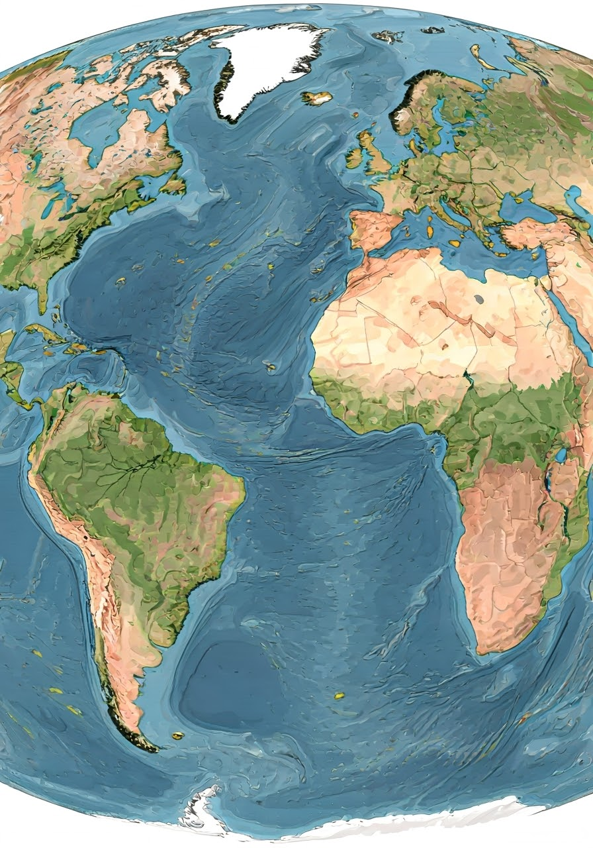
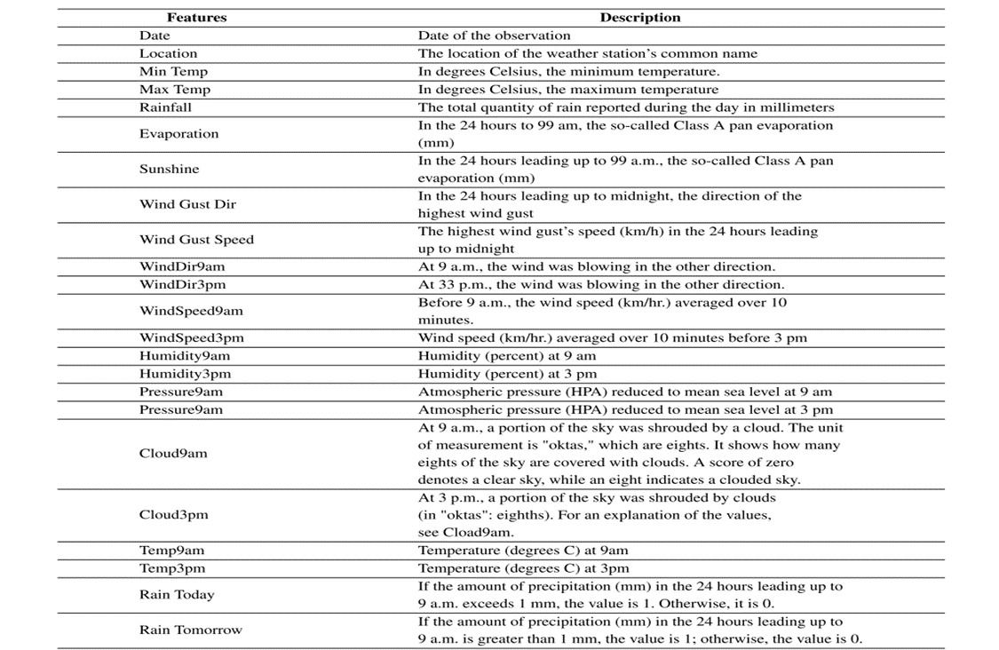
DATASET SAMPLE

Slide 14

CONCLUSION
In conclusion, the project focuses on leveraging machine learning techniques to build a robust model that can forecast whether it rains in 24 hours based on today's weather parameters and then integrate it to a web interface created using flask enable user to input the parameters and get the result.
I believe this project has great potential and look forward to bringing it to life.

Slide 15

THANK YOU

Slide 16
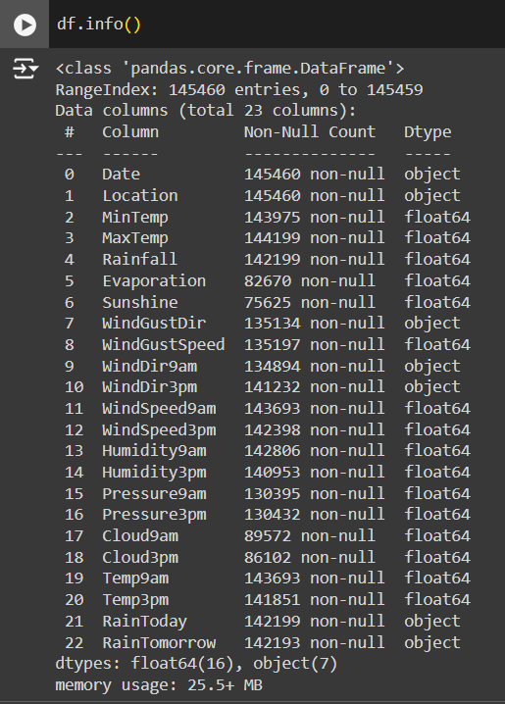
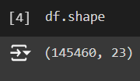
EXPLORATORY ANALYSIS
Figure 1
Dataset has 145460 instances and 23 columns.
Dataset contains 16 numerical attributes and 7 non
numerical attributes.
Figure 2

Slide 17
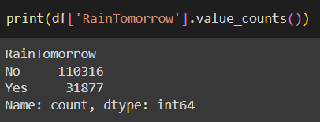
Figure 3
Target variable is RainTomorrow. It has two values:
Yes: it will rains in 24 hours
No: it will not rains in 24 hours
Number of rows with value Yes is 31877
Number of rows with value No is 110316

Slide 18
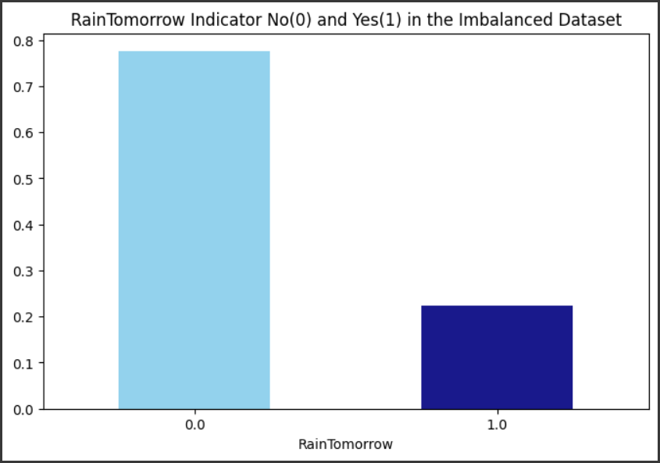
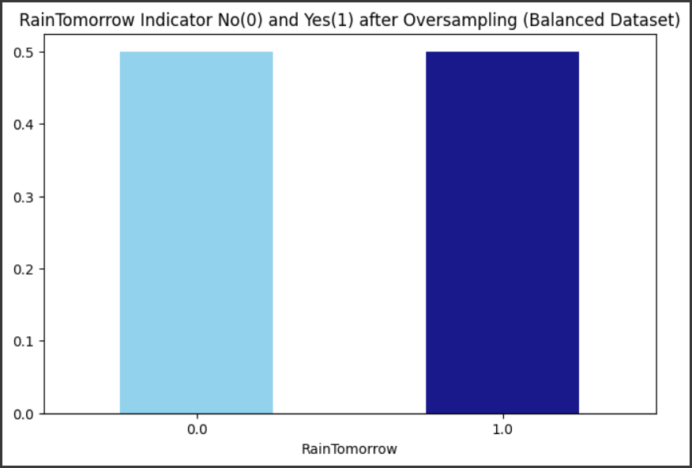
DATA PREPROCESSING
1. Check whether dataset is balanced or not
Figure 4
Figure 5
Kind of Plot: Bar plot (kind='bar')
X-label: represents the two classes of 'RainTomorrow': 'No' (represented as 0) and 'Yes' (represented as 1).
Y-label: represents the normalized count or proportion of each class.
Legend: No explicit legend is used, but the colors of the bars (skyblue for 'No' and navy for 'Yes') differentiate the classes.
Dataset contains value ‘No’ more than ‘Yes’ for target variable RainTomorrow, so it is imbalanced and has to be balanced.
Used oversampling approach for balancing the dataset.

Slide 19
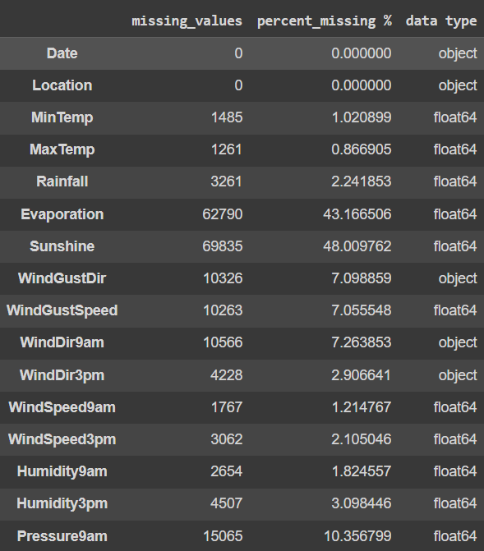
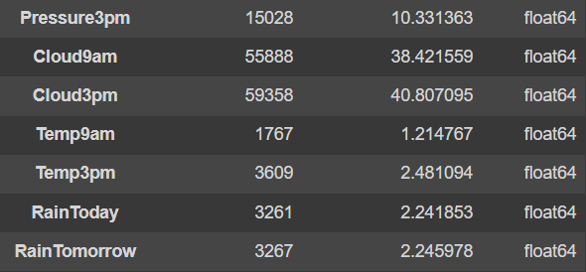
2. Identification of Missing Values
Count and percentage of missing values and the datatypes of each feature in the original dataset is given
Figure 6

Slide 20
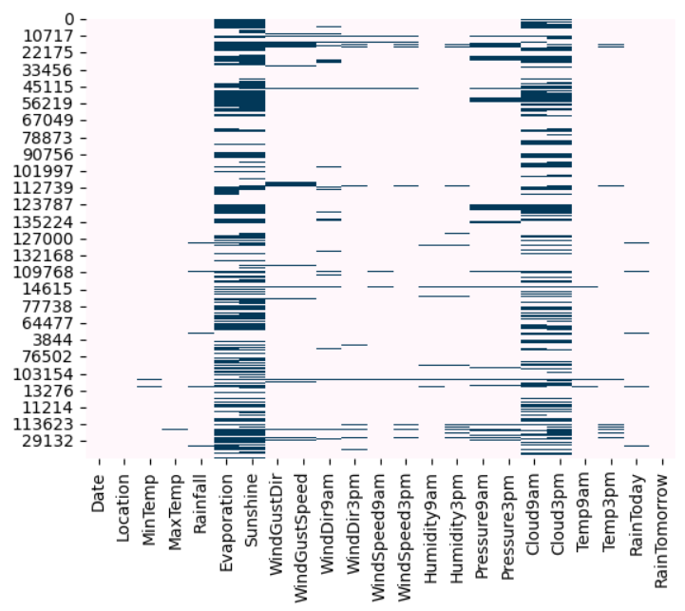
Missing Data Pattern in Oversampled dataframe
X-label: names of the columns (features) in oversampled DataFrame.
Y-label: numerical indices representing the rows (data instances) in oversampled DataFrame.
Legend: Since cbar=False, there is no explicit legend. However, the color intensity within the heatmap represents the presence (darker shade) or absence (lighter shade) of missing values.
From Figure 7, “Evaporation”, “Sunshine”, “Cloud9am”, “Cloud3pm” are the features with a high missing percentage. So we will check the details of the missing data for these 4 features.
Figure 7

Slide 21
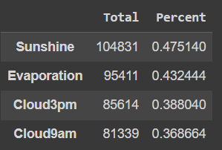
Figure 8
Figure 8 shows the count and percentage of the 4 features in the oversampled dataframe,which has less than 50 percent missing data. So instead of rejecting them completely, we’ll consider them in our model with proper imputation.

Slide 22
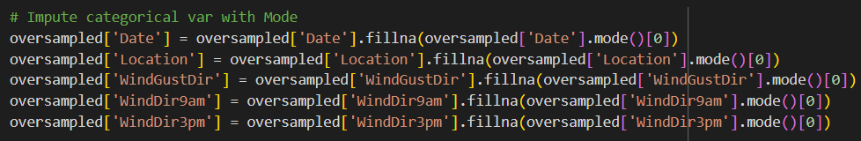
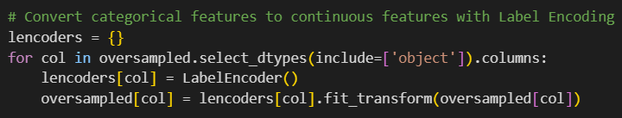
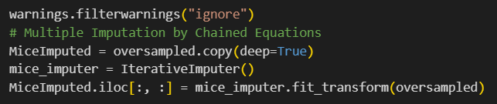
3. Imputation and Transformation
Impute the categorical columns with mode, and then by using the label encoder , converting them to numeric numbers. Once all the columns in the full data frame are converted to numeric columns, then impute the other missing values ​​using the Multiple Imputation by Chained Equations (MICE) package
Figure 9
Figure 9 shows the replacing of all null values in the non numerical features with the mode.
Figure 10
Figure 10 shows label Encoding; categorical features are converted to continuous features.
Figure 11 shows Multiple Imputation by Chained Equations .After these process there will be no missing values in the dataset.
Figure 11

Slide 23
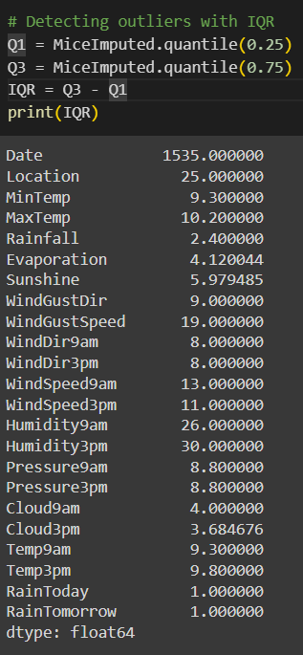

4. Detecting and Removing outliers
Detect outliers using the interquartile range and removed them to get the final working dataset.
After the removal of outliers, the dataset reduced to 170669 instances and 23 columns.So 25206 instances are removed from the dataset.
Figure 12
Figure 13

Slide 24
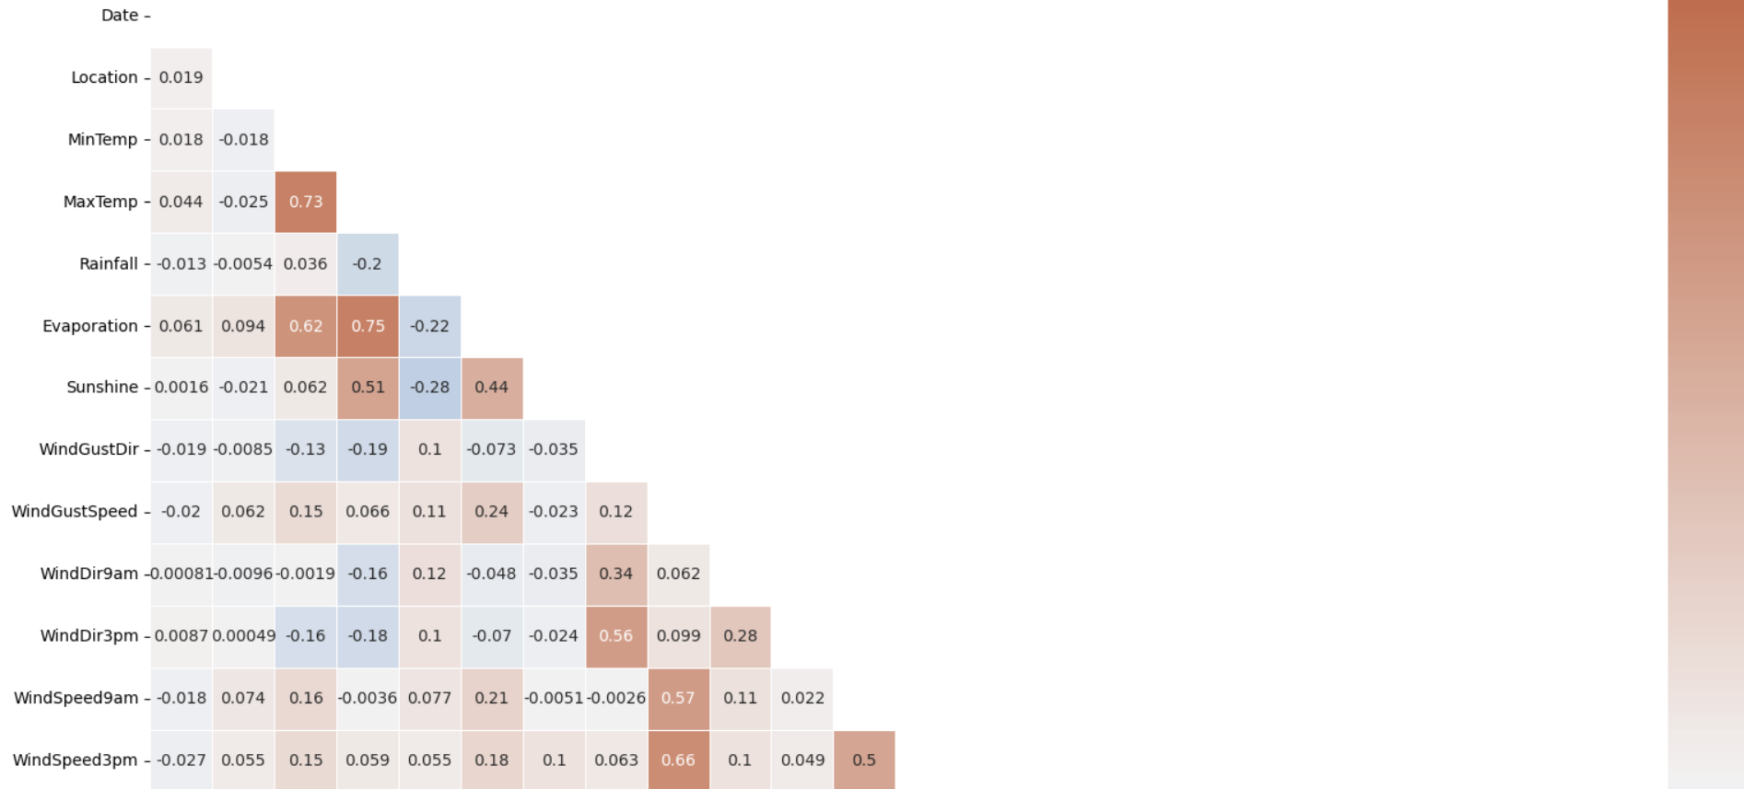
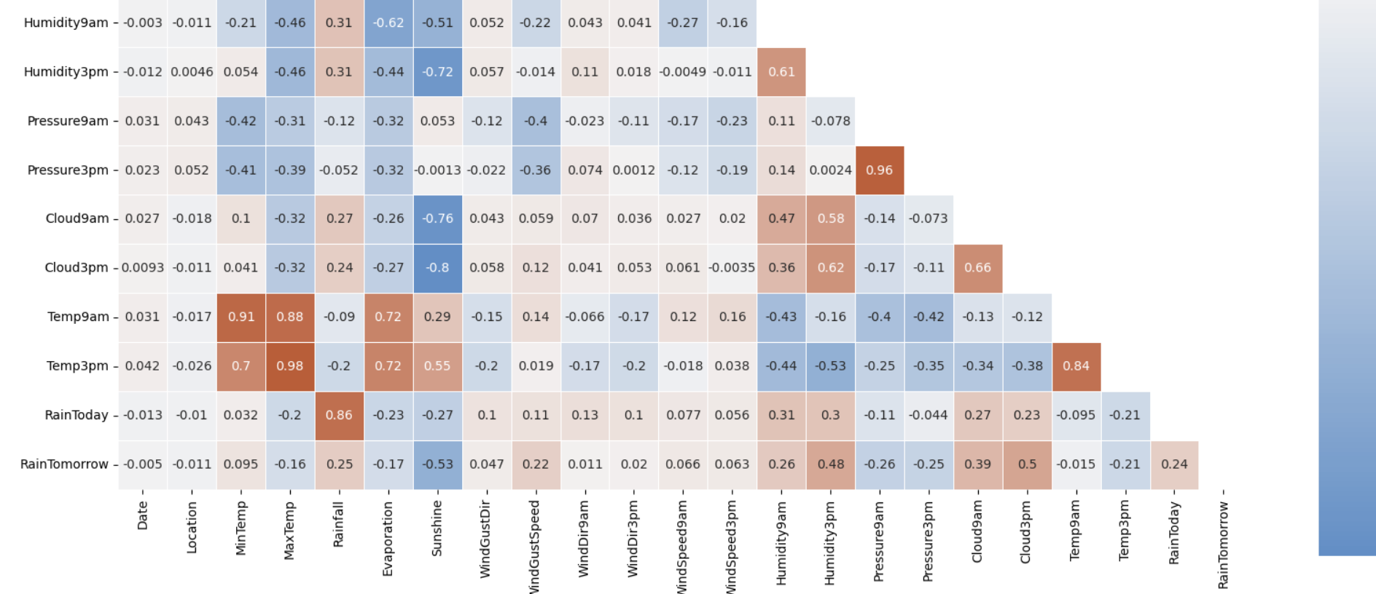
DATASET VISUALIZATION
Correlation between the different variables
Type: Heatmap.
X-label: names of the columns (features) in the preprocessed DataFrame
Y-label: names of the columns (features) in the preprocessed DataFrame
Legend: While there's no explicit legend, the color intensity and annotations on the heatmap convey the information:
Color Intensity: Represents the strength of the correlation. Darker colors typically indicate stronger positive correlations, lighter colors indicate weaker correlations, and colors in the middle (around zero) indicate no or weak correlations
Annotations: The numbers within each cell of the heatmap represent the actual correlation coefficient between the corresponding pair of features.
This heatmap visualizes the pairwise correlations between all numerical features in the dataset, helping identify potential multicollinearity (high correlations between independent variables) and understand relationships between features.
feature pairs have a strong correlation with each other:
MaxTemp and Temp3pm
Pressure3pm and Pressure9am
Temp9am and MinTemp
Temp9am and MaxTemp
RainToday and RainFall
Figure 14

Slide 25
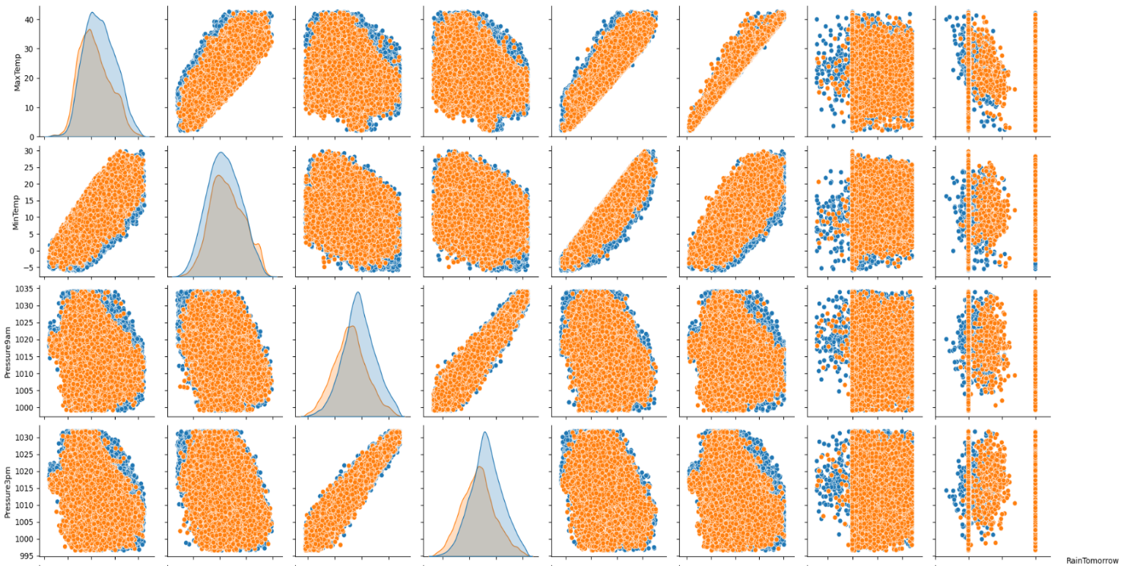
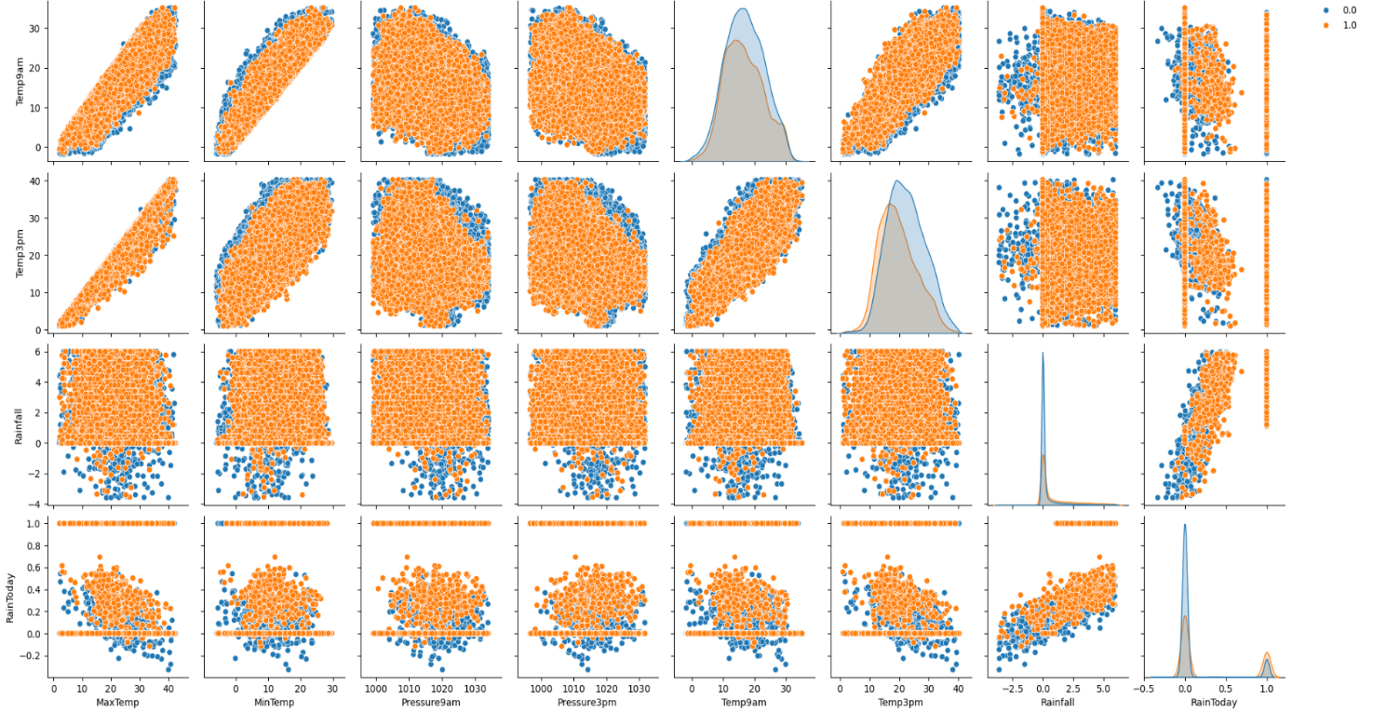
Type: Scatterplot
X-label: The range of values of the feature being plotted.
Y-label: The range of values of the feature being plotted.
Legend: if yellow it rains, else no rain
Each of the paired plots shows very clear distinct clusters of RainTomorrow’s “yes” and “no” clusters. There is very minimal overlap between them.
Figure 13

Slide 26
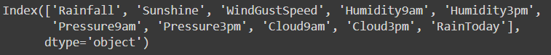
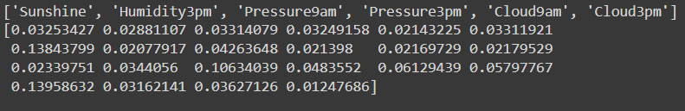
Feature Selection for Rainfall Prediction
Filter method and the wrapper method are used for feature selection to train the rainfall prediction models. Features are selected by filtering method (chi-square value). Before doing this, it is important to normalize our dataset. Using MinMaxScaler instead of StandardScaler in order to avoid negative values.
Feature Importance using Filter Method (Chi-Square)
10 best features selected using Chi –Square.
Figure 14
Selection of features by wrapping method (random forest)
Sunshine,Humidity3pm,Pressure9am,Pressure3pm,Cloud9am,Cloud3pm are the features selected for predicting rainfall.
Figure 15

Slide 27
ALGORITHMS AND PSEUDOCODES
Algorithms used in ‘Rainfall Prediction Using Machine Learning’ are :
Artificial Neural Networks
Support Vector Machine
Random Forest

Slide 28
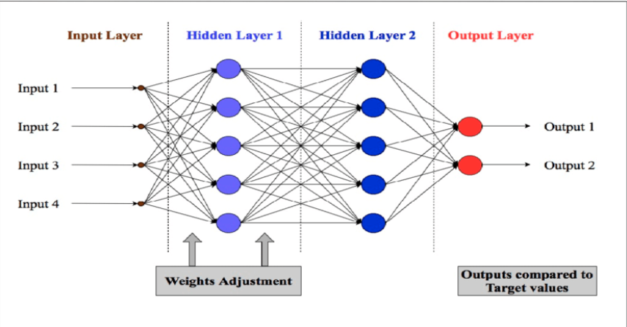
Artificial Neural Networks (ANN)
Artificial Neural Networks (ANNs) are computational models inspired by the human brain's neural networks. They consist of interconnected nodes (neurons) arranged in layers: an input layer, one or more hidden layers, and an output layer. Each neuron processes input data through weighted connections and activation functions to produce output. ANNs are particularly powerful in capturing complex patterns in data, making them suitable for a wide range of tasks, including classification, regression, and more.

Slide 29
Algorithm
Initialization:
Initialize the weights and biases for all layers of the network randomly.
Forward Propagation:
For each input sample, calculate the output of each neuron by computing the weighted sum of inputs and applying the activation function.
Pass the output from the input layer through the hidden layers and finally to the output layer.
Loss Calculation:
Compute the loss by comparing the predicted output with the actual target using a loss function (e.g., Mean Squared Error for regression or Cross-Entropy for classification).
Backpropagation:
Calculate the gradient of the loss function with respect to each weight and bias using the chain rule.
Update the weights and biases by moving them in the direction that reduces the loss, typically using an optimization algorithm like Gradient Descent.
Iteration:
Repeat the forward propagation, loss calculation, and backpropagation steps for multiple epochs until the model converges (i.e., the loss stops decreasing significantly).
Prediction:
After training, use the trained network to make predictions on new data.

Slide 30
Pseudocode
Initialize weights and biases
For each epoch:
For each input sample:
Perform forward propagation through all layers
Calculate the loss
Perform backpropagation to update weights and biases
End For
End For
Use the trained model to make predictions

Slide 31
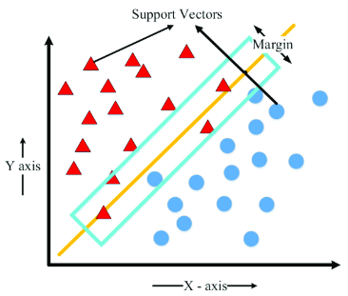
2. Support Vector Machines (SVM)
Support Vector Machines (SVMs) are supervised learning models used for classification and regression tasks. SVMs work by finding the optimal hyperplane that best separates data points of different classes in a feature space. The data points that are closest to the hyperplane are called support vectors. SVMs are effective in high-dimensional spaces and are especially useful for binary classification.

Slide 32
Algorithm
Data Preparation:
Represent the input data as feature vectors.
Hyperplane Selection:
Find the hyperplane that maximizes the margin between the two classes. The margin is the distance between the hyperplane and the nearest data point from either class.
Optimization:
Use optimization techniques (like Quadratic Programming) to minimize the classification error and maximize the margin.
Support Vectors:
Identify the support vectors, which are the data points closest to the hyperplane.
Kernel Trick (Optional):
If the data is not linearly separable, apply a kernel function (e.g., RBF, Polynomial) to transform the data into a higher-dimensional space where a linear separation is possible.
Prediction:
Use the optimal hyperplane (or decision boundary) to classify new data points.

Slide 33
Pseudocode
Transform the input data using a kernel function (if needed)
Find the optimal hyperplane that maximizes the margin
Identify support vectors
For each new input sample:
Calculate the decision function based on the hyperplane
Assign the sample to a class based on the sign of the decision function

Slide 34
3. Random Forest (RF)
Random Forest is an ensemble learning method that builds multiple decision trees and merges their outputs to make a more accurate and stable prediction. Each tree is built using a random subset of features and data samples, making the model less prone to overfitting and more robust. Random Forest is widely used for both classification and regression tasks.

Slide 35
Algorithm
Bootstrap Sampling:
Randomly select samples from the training data (with replacement) to create multiple datasets (bootstrap samples).
Tree Construction:
For each bootstrap sample, construct a decision tree by recursively splitting the data based on the best feature that maximizes the separation of classes (or minimizes the error in regression).
During the construction, at each split, randomly select a subset of features to choose the best split from.
Aggregation:
After all trees are built, aggregate their predictions:
For classification, use majority voting (i.e., the class that gets the most votes is the final prediction).
For regression, average the predictions from all trees.
Prediction:
Use the aggregated output from all trees to make the final prediction for new data.

Slide 36
Pseudocode
For each tree in the Random Forest:
Bootstrap sample the data
Randomly select a subset of features for each split
Build the decision tree using the selected features and bootstrap sample
Repeat until the maximum depth or minimum sample size is reached
End For
For each new input sample
Pass the sample through each decision tree in the forest
Record the output (class or regression value) from each tree
Aggregate the outputs:
- For classification: Use majority voting to determine the final class label
- For regression: Compute the average of the outputs to get the final prediction
Return the aggregated result as the final prediction

Slide 37
PACKAGES AND FUNCTIONS
Packages
pandas as pd
numpy as np
seaborn as sns
matplotlib.pyplot as plt
sklearn.utils: resample
Warnings
sklearn:
preprocessing
feature_selection
SelectKBest
chi2
SelectFromModel
ensemble
RandomForestClassifier (imported as rf)
experimental
enable_iterative_imputer
impute
IterativeImputer
preprocessing
LabelEncoder
model_selection
train_test_split
neural_network
MLPClassifier
svm
SVC
metrics
accuracy_score

Slide 38
Functions
read_csv(): Reads data from a CSV file into a Pandas DataFrame.
shape: Returns the dimensions (rows, columns) of a DataFrame.
info(): Prints a summary of a DataFrame, including data types and non-null values.
replace(): Replaces values in a DataFrame.
value_counts(): Counts the occurrences of unique values in a Series.
plot(): Creates various types of plots (bar plot in this case).
title(): Sets the title of a plot.show(): Displays the plot.
concat(): Concatenates DataFrames along an axis.
isnull(): Detects missing values in a DataFrame.
sum(): Calculates the sum of values.
sort_values(): Sorts a DataFrame by values in one or more columns.
head(): Returns the first few rows of a DataFrame.
select_dtypes(): Selects columns based on their data types.
fillna(): Fills missing values.
mode(): Returns the most frequent value(s) in a Series.
LabelEncoder(): Creates a LabelEncoder object for converting categorical labels to numerical values.
fit_transform(): Fits a transformer (like LabelEncoder) to data and then transforms it.
filterwarnings(): Controls the display of warning messages.
copy(): Creates a deep copy of a DataFrame.
IterativeImputer(): Creates an IterativeImputer object for multiple imputation.
quantile(): Computes quantiles of a DataFrame.
any(): Returns True if any element in a boolean array is True.

Slide 39
• corr(): Computes the pairwise correlation of columns in a DataFrame.
• triu(): Returns the upper triangle of an array.
• subplots(): Creates a figure and a set of subplots.
• heatmap(): Generates a heatmap plot.
• diverging_palette(): Creates a diverging color palette.
• pairplot(): Generates a pair plot to visualize relationships between variables.
• MinMaxScaler(): Creates a MinMaxScaler object for scaling numerical features.
• transform(): Transforms data using a fitted scaler or transformer.
• loc[]: Accesses a group of rows and columns by labels.
• SelectKBest(): Selects features based on the k highest scores.
• fit(): Fits a feature selector to data.
• transform(): Transforms data using a fitted feature selector.
• get_support(): Returns a boolean mask indicating selected features.
• drop(): Removes rows or columns from a DataFrame.
• SelectFromModel(): Selects features based on importance weights from a model.
• feature_importances_: Returns feature importance scores from a fitted model.
• train_test_split(): Splits data into training and testing sets.
• MLPClassifier(): Creates a Multi-Layer Perceptron (neural network) classifier.
• SVC(): Creates a Support Vector Classifier.
• predict(): Predicts target values using a trained model.
• accuracy_score(): Calculates the accuracy score of model predictions.

Slide 40
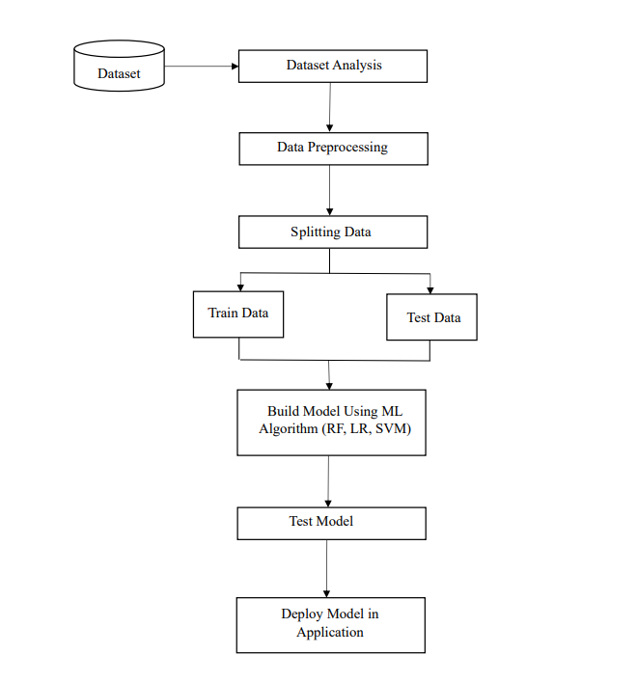
PROJECT PIPELINE

Slide 41
TIMELINE
Submission of project synopsis with Journal Papers - 22.07.2024
Project proposal approval - 26.07.2024
Presenting project proposal before the Approval Committee - 29.07.2024 & 30.07.2024
Initial report submission - 12.08.2024
Analysis and design report submission - 16.08.2024
First Project Presentation - 21.08.2024 & 23.08.2024
Sprint Release I - 30.08.2024
Sprint Release II - 26.09.2024
Interim Project Presentation - 30.09.2024 & 01.10.2024
Sprint Release III - 18.10.2024
Submission of the project report to the guide - 28.10.2024
Final project presentation - 28.10.2024 & 29.10.2024
Submission of project report after corrections - 01.11.2024

Slide 42
THANK YOU

Slide 43
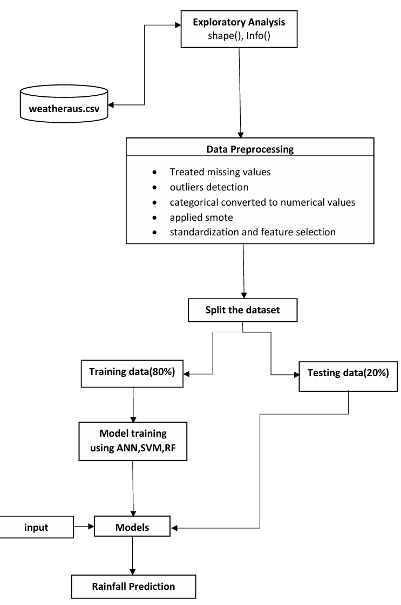
MODIFIED PIPELINE

Slide 44
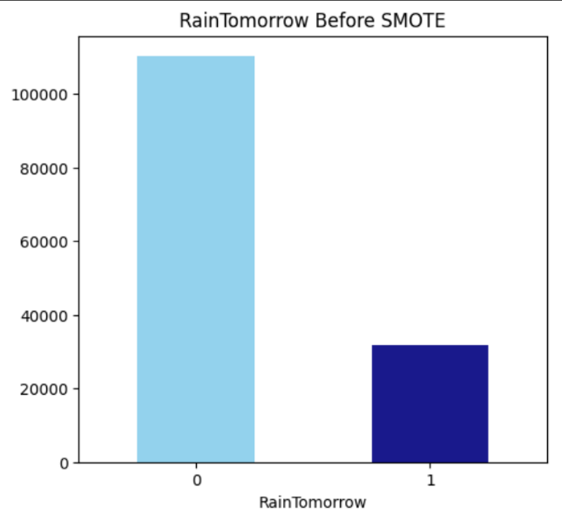
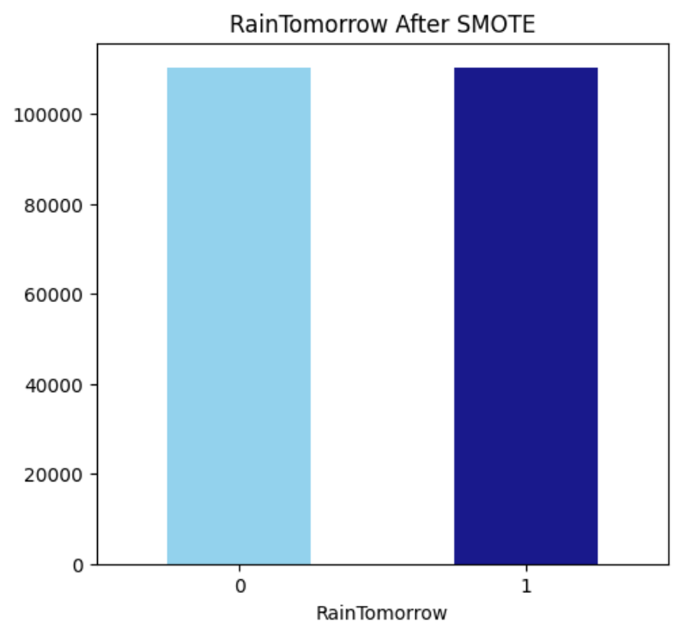
Replaced oversampling by smote to balance the dataset
Kind of Plot: Bar plot (kind='bar')
X-label: the x-label represents the two classes of 'RainTomorrow': 'No' (represented as 0) and 'Yes' (represented as 1).
Y-label: Ithe y-label represents the normalized count or proportion of each class.
Legend: No explicit legend is used, but the colors of the bars (skyblue for 'No' and navy for 'Yes') differentiate the classes.
After smote , the number of instances became 220632.

Slide 45
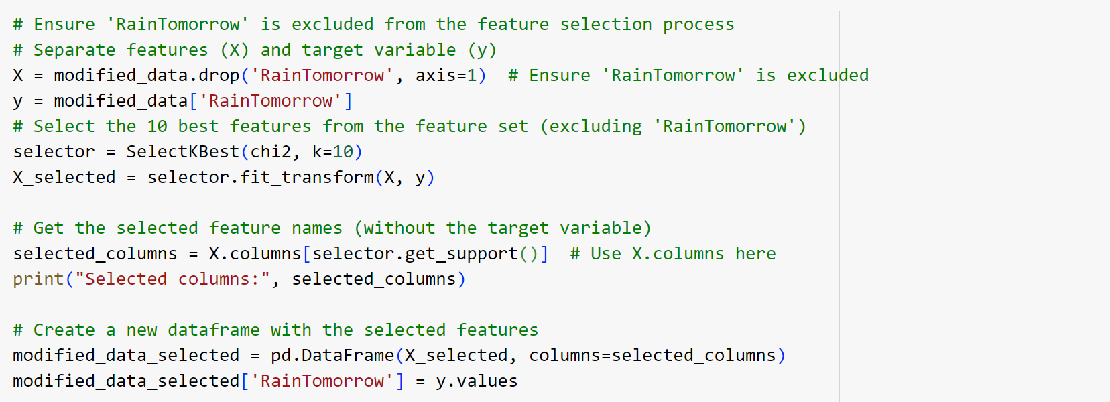

Feature Selection for Rainfall Prediction
Using chi square, 10 important features are selected.
Features selected:

Slide 46
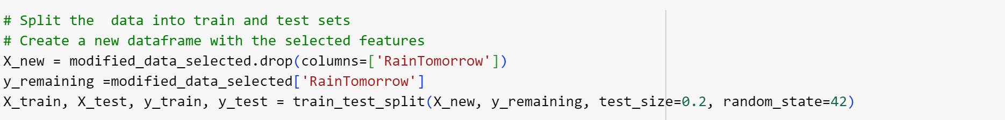
MODEL BUILDING
Dataset is split in to two sets: 80% of datapoints for training and 20% for testing. train_test_split function is used to divide the data into training and testing sets.

Slide 47
ANN MODEL
Created an ANN model with the following parameters:
random_state=42: Ensures consistent results for reproducibility.
verbose=1: Prints progress messages during training.
hidden_layer_sizes=(100, 50): Defines a network with two hidden layers containing 100 and 50 neurons, respectively.
activation='relu': Uses the ReLU activation function for neurons.
solver='adam': Employs the Adam optimization algorithm for weight updates.

Slide 48
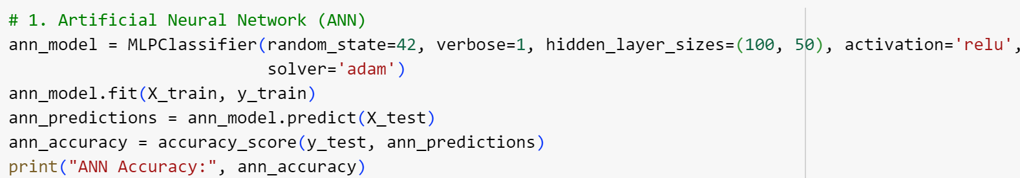
Trained the ANN model on the training data and this model is used to predict the target variable for the test data .The accuracy of the model is checked by comparing the predicted values (ann_predictions) to the actual values (y_test).
Test accuracy : 0.8789665887903464
Training accuracy : 0.8817148203805041

Slide 49
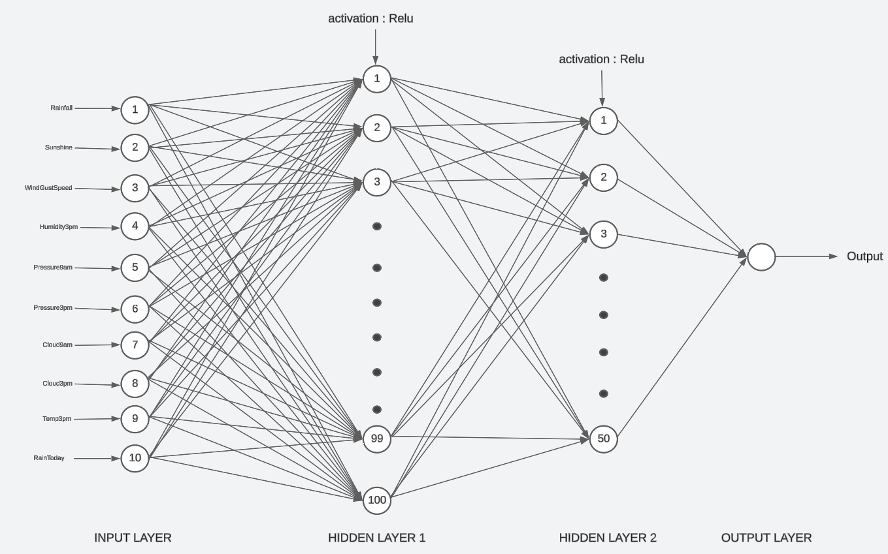

Slide 50
SVM MODEL
Created an SVM model with the following parameters:
random_state=42: Ensures consistent results for reproducibility.
C=1: Sets the regularization parameter.
kernel='linear': Uses a linear kernel for the SVM.

Slide 51
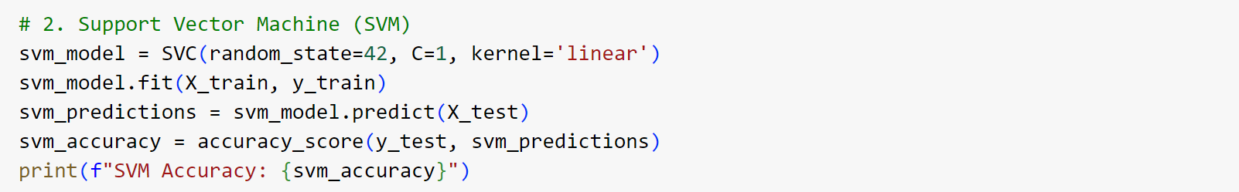
Trained the SVM model on the training data and this model is used to predict the target variable for the test data .The accuracy of the model is checked by comparing the predicted values (svm_predictions) to the actual values (y_test).
Test accuracy : 0.8099439744142264
Training accuracy : 0.8104624457739091

Slide 52
RF MODEL
Created an RF model with the following hyperparameters:
max_depth: 16
min_samples_leaf: 1
min_samples_split: 2
n_estimators: 100
random_state: 12345

Slide 53
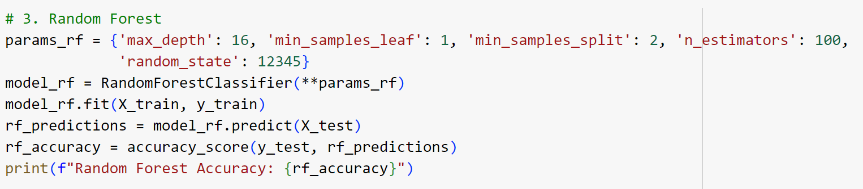
Trained the RF model on the training data and this model is used to predict the target variable for the test data .The accuracy of the model is checked by comparing the predicted values (rf_predictions) to the actual values (y_test).
Test accuracy : 0.8994261346882301
Training accuracy : 0.966508832118858

Slide 54
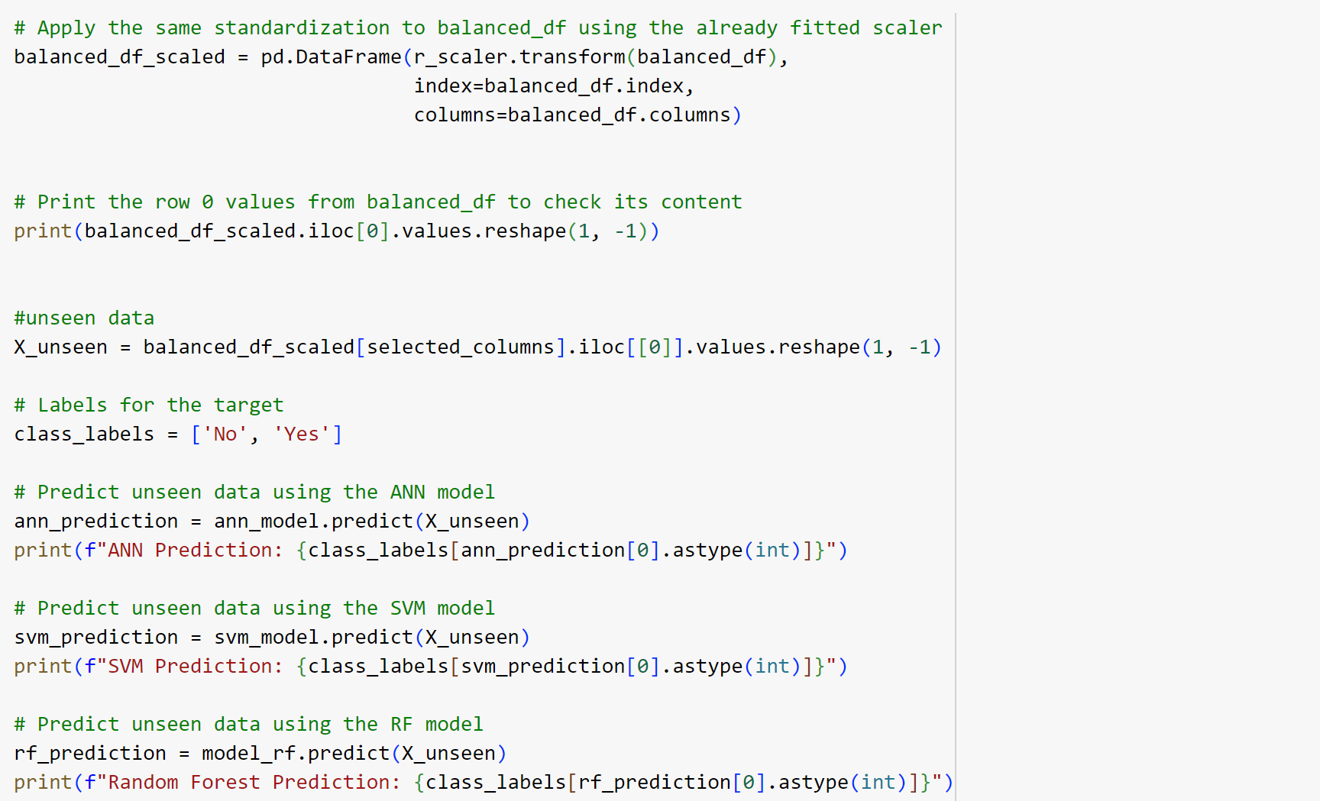

PREDICTION USING UNSEEN DATA
X_unseen has the unseen data. All three models predict whether it rains in 24 hours or not.If ‘Yes’ it prints ‘Yes’ and if it’s ‘No’ it prints ‘No’. Following figure shows the predictions of three models.

Slide 55
CONCLUSION
FROM THE ABOVE THREE MODELS RANDOM FOREST MODEL HAS THE HIGHEST TRAINING AND TESTING ACCURACY.

Slide 56
THANK YOU

Slide 57
RAINFALL PREDICTION
Using Machine Learning
By: DONA JINCE
Reg No: MAC23MCA-2024
Under the guidance of:
Prof. Sonia Abraham

Slide 58
SUMMARY
Algorithms: ANN,SVM,RF
Dataset : WeatherAUS.csv
Data preprocessing:
Treated missing values
Applied SMOTE to balance the dataset
Feature selection(f_classif): 10 most important features were selected
Normalization using minmaxscaler
Splitting the dataset: 80% for training,20% for testing.
3 models were created.
Models are evaluated based on accuracy,recall,precision and f1 score.

Slide 59
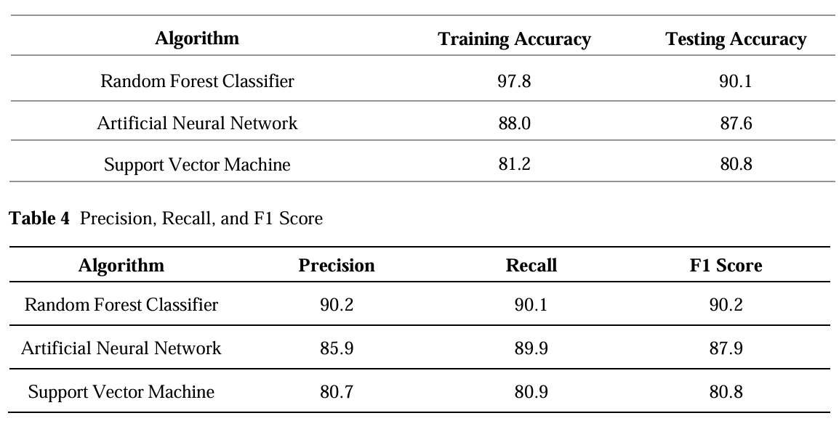


RESULTS
RANDOM FOREST SHOWED THE BEST PERFORMANCE.

Slide 60
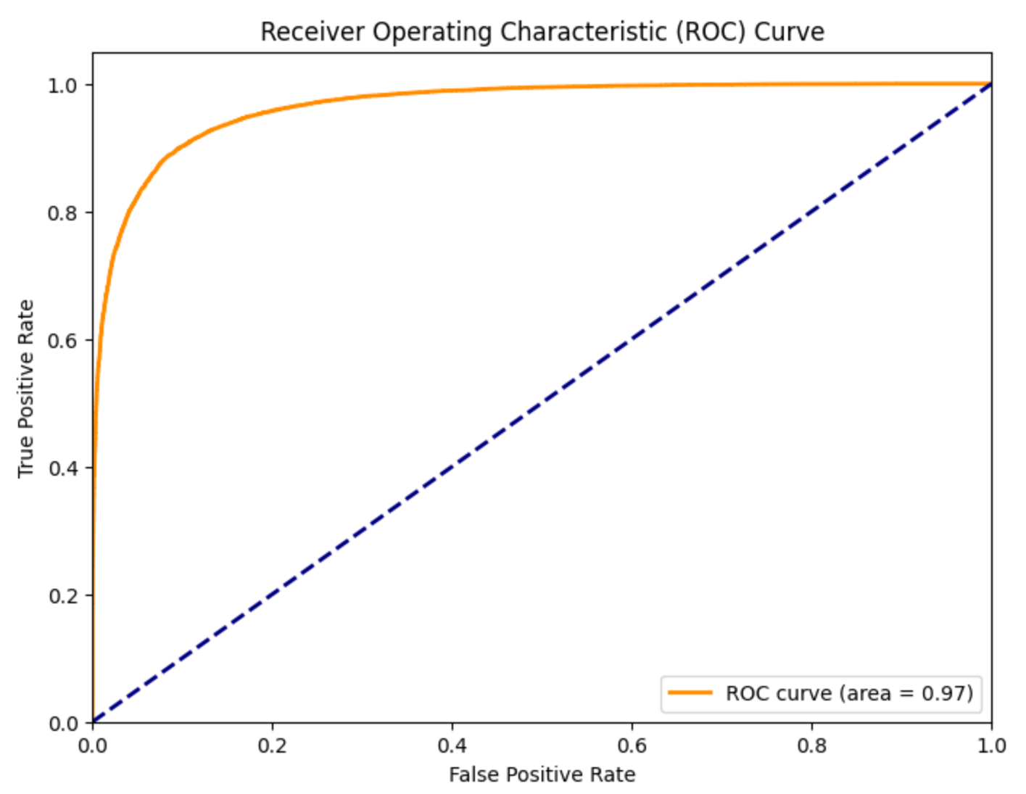

Slide 61
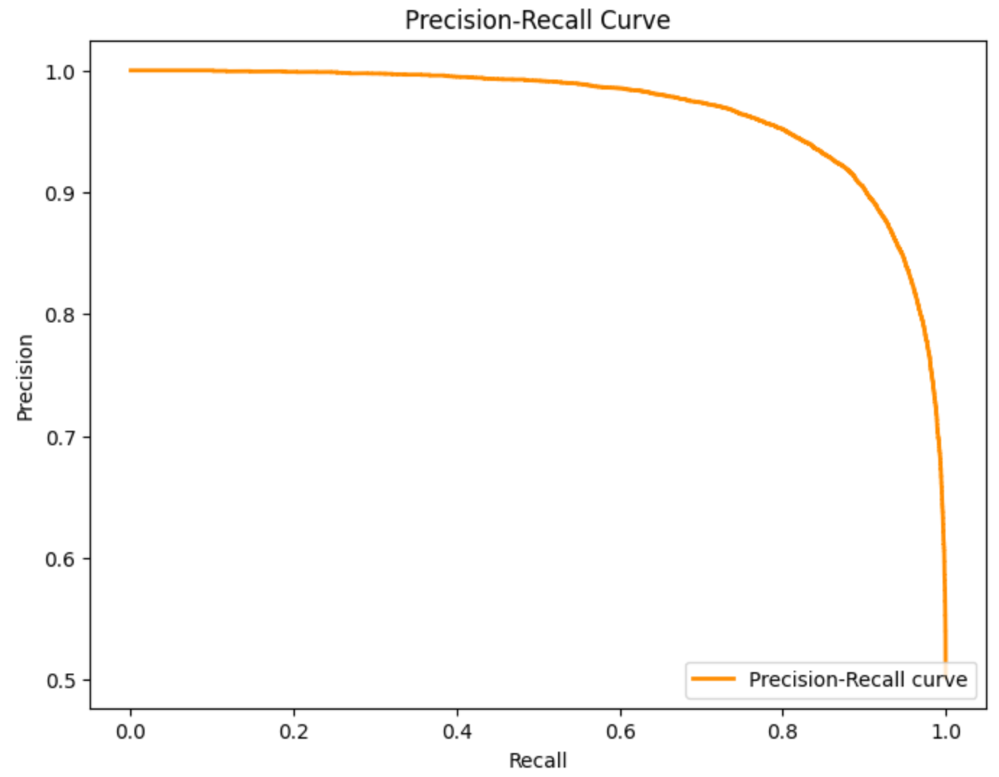

Slide 62
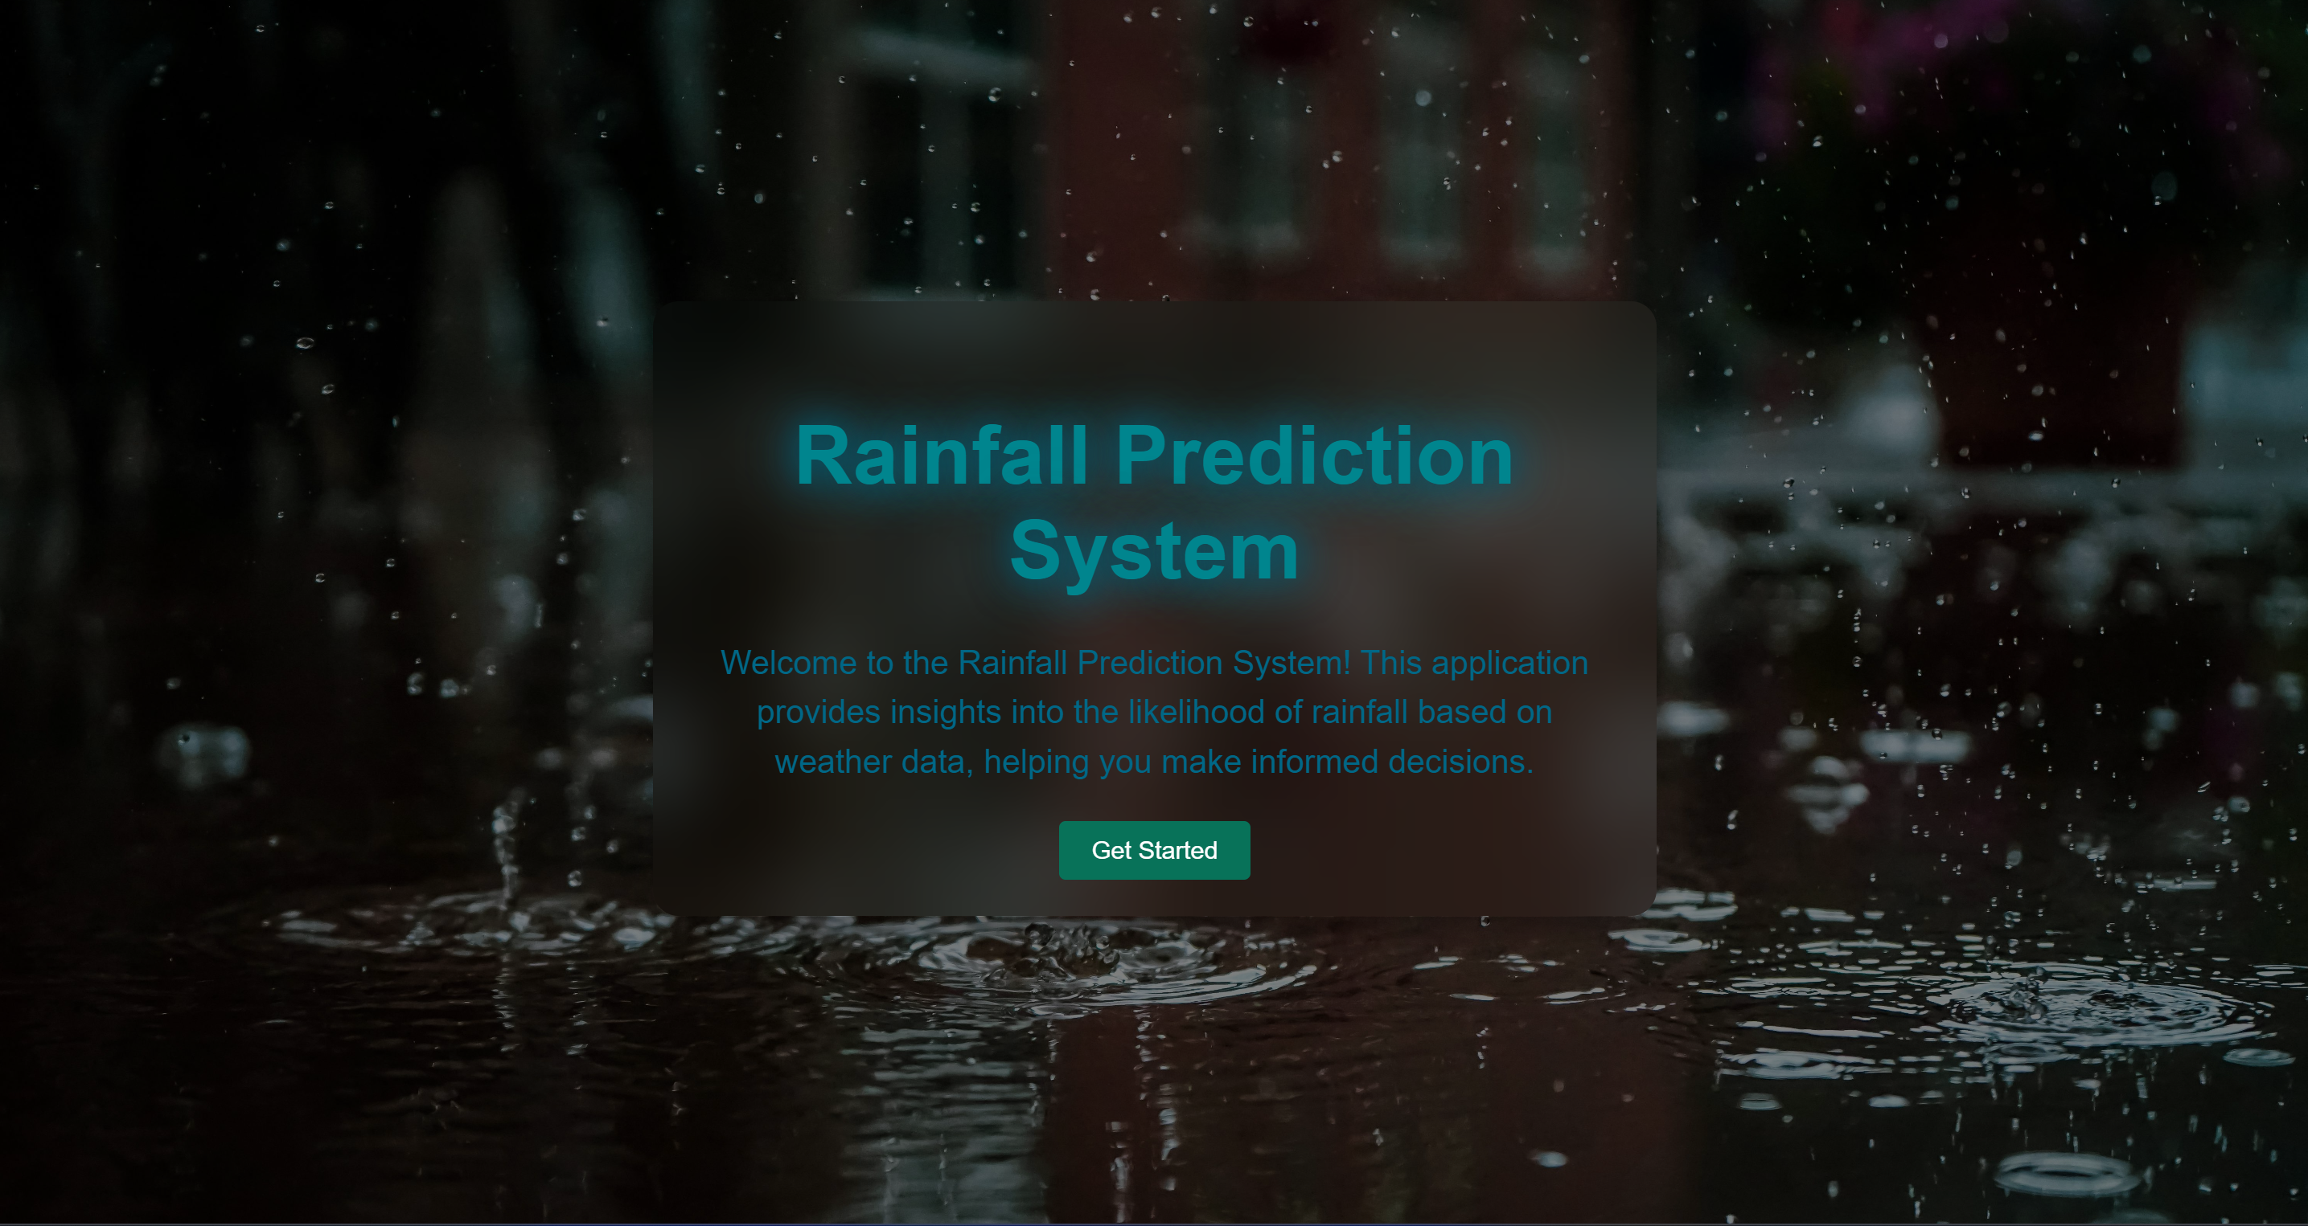
HOME PAGE

Slide 63
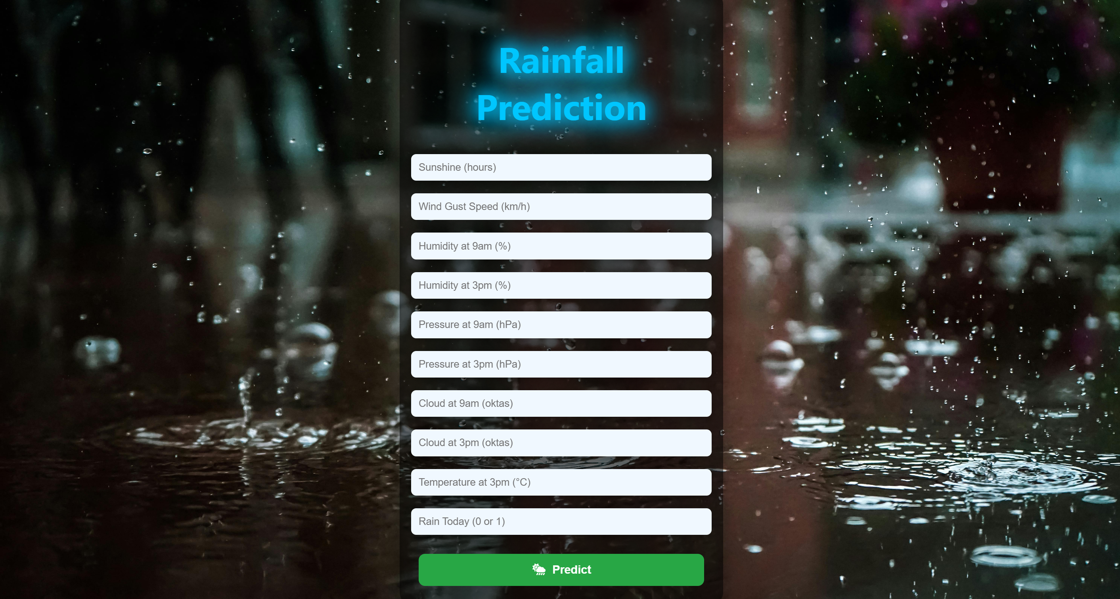
INPUT FORM PAGE

Slide 64
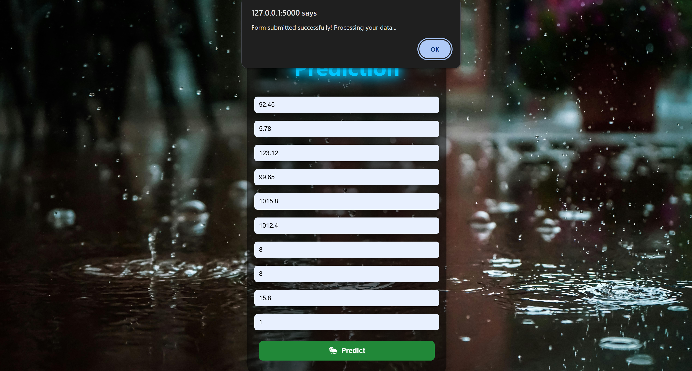
MESSAGE WHILE SUBMITTING INPUT DATA

Slide 65

OUTPUT

Slide 66
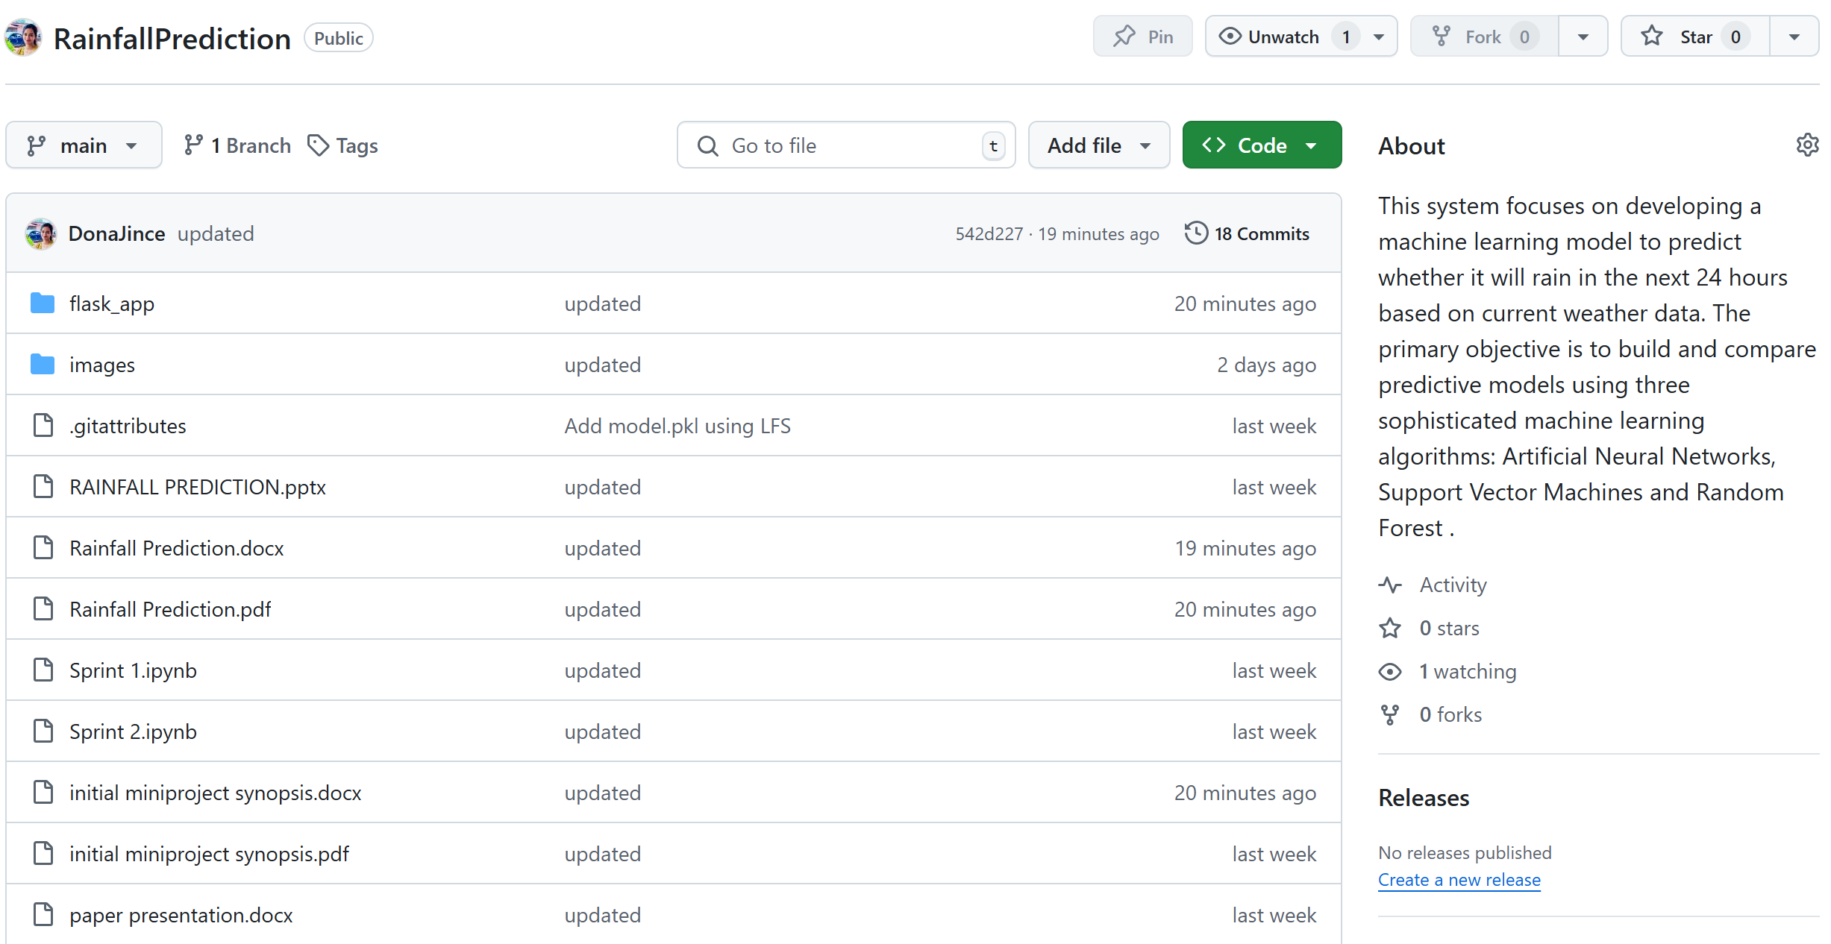
GIT HISTORY

Slide 67
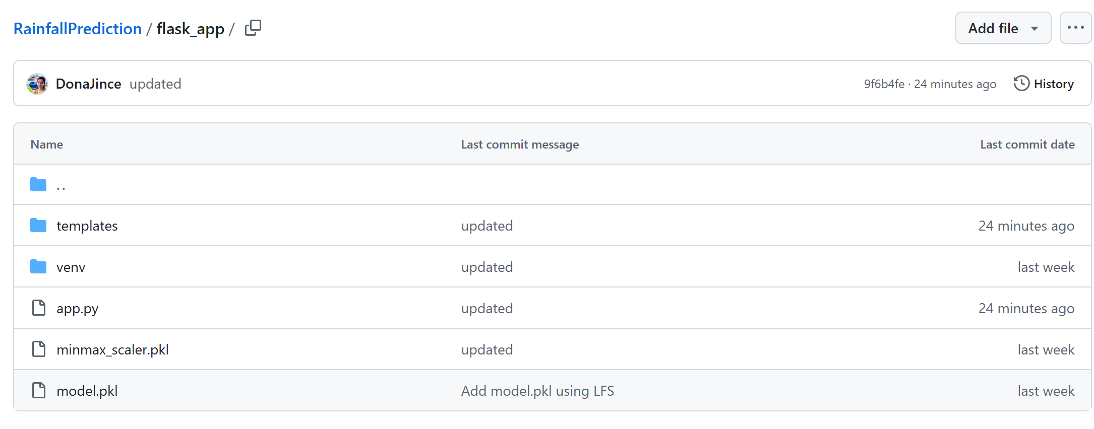
GIT HISTORY OF WEB INTERFACE

Slide 68
THANK YOU

